Slide 1
Digital Portfolio
STUD
STUDENT NAME: Rayappan S
REGISTER NO:autbruau2422K1181
NMID: 6BC9D7D7B019B18BE8E4E6F37541AAE0
DEPARTMENT: II-B.Sc(Computer Science)
COLLEGE : Government Arts and Science College (Co-Education), Avinashi

Slide 2
PROJECT TITLE
Interactive Portfolio Website
using HTML, CSS, and JavaScript

Slide 3

AGENDA
Problem Statement
Project Overview
End Users
Tools and Technologies
Portfolio design and Layout
Features and Functionality
Results and Screenshots
Conclusion
Github Link
3/21/2024 Annual Review

Slide 4

PROBLEM STATEMENT
Traditional resumes and academic records do not fully reflect a student’s technical skills, creativity, and practical projects. A digital portfolio bridges this gap by showcasing skills and achievements in an interactive way.

Slide 5

PROJECT OVERVIEW
The project is a Digital Portfolio Website that highlights technical skills, academic background, certifications, and projects. It serves as a personal branding tool for students and professionals to present their capabilities effectively.

Slide 6

WHO ARE THE END USERS?
1Recruiters & Hiring Managers → To evaluate my skills, projects,
and certifications.
2.Clients / Companies → To contact me for freelance or job
opportunities.
3.Peers & Developers → To get inspired or collaborate on
projects.
4.Myself → To maintain a digital identity showcasing my career
journey.

Slide 7

TOOLS AND TECHNIQUES
Frontend: HTML5, CSS3, JavaScript (Vanilla JS).
Design: Responsive layout, animations, modal popups.
Hosting: Online platforms (GitHub Pages / Netlify / Vercel).
Assets: Postimages for certificates, resume, and profile
images.

Slide 8
POTFOLIO DESIGN AND LAYOUT
Clean and modern user interface
Sections for Skills, Projects, Certificates, and Contact
Mobile-first responsive design
Smooth transitions and animations
8

Slide 9
FEATURES AND FUNCTIONALITY
✅ Responsive design with mobile-first approach.
✅ Modal popup for certificates and resume.
✅ Hover animations on skills and profile image.
✅ Contact form with name, email, phone, and project details.
✅ Fixed navigation bar with smooth scrolling.
✅ Dark modern theme with glowing accent colors.

Slide 10

RESULTS AND SCREENSHOTS
*Portfolio successfully created and deployed online
*Works across devices (desktop, tablet, mobile)
*Professional layout with interactive sections
Simple and user-friendly interface
3/21/2024 Annual Review
10

Slide 11
CONCLUSION
*The portfolio website solved the challenge of presenting my skills
and achievements dynamically. It reflects my knowledge of frontend
technologies (HTML, CSS, JavaScript) and provides recruiters with a
user-friendly way to explore my profile.
This project improved my skills in UI/UX design, responsive layouts,
and JavaScript interactivity.
11

Slide 13
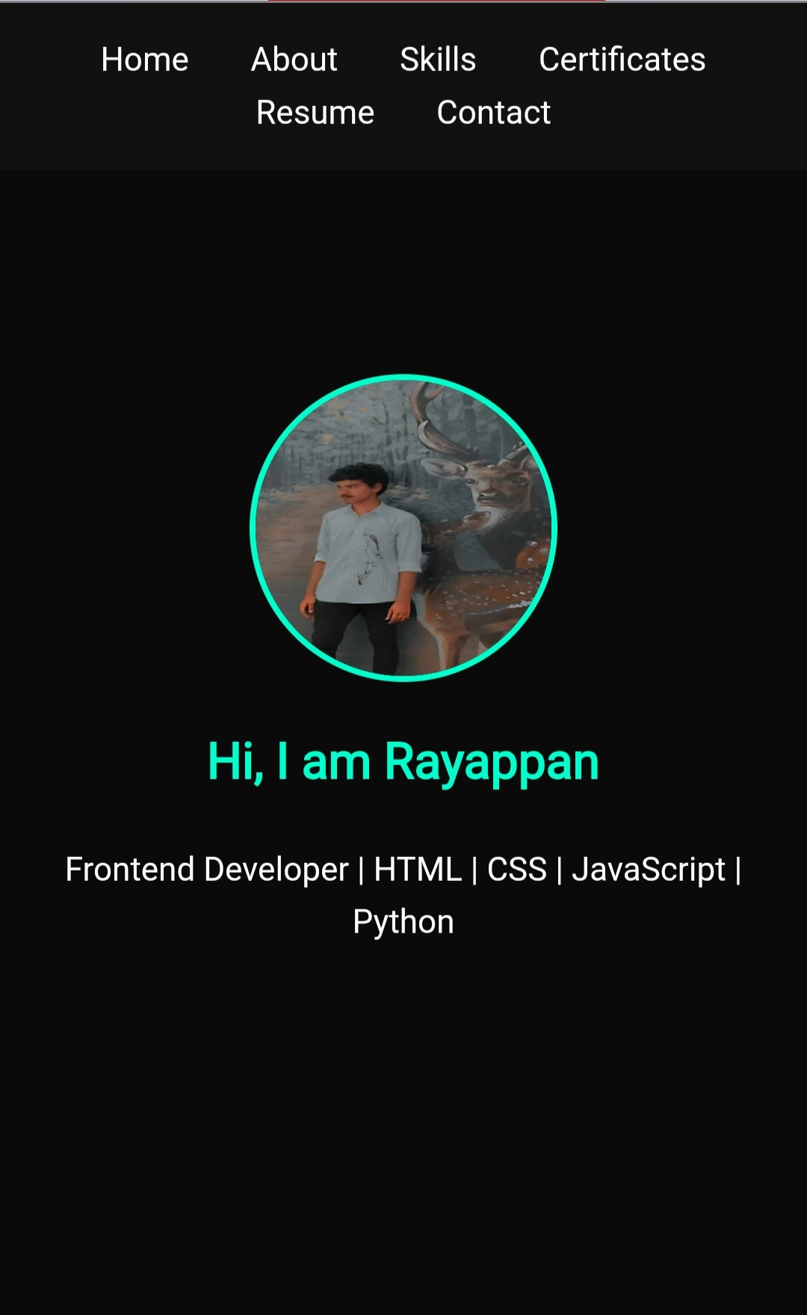
Home

Slide 14
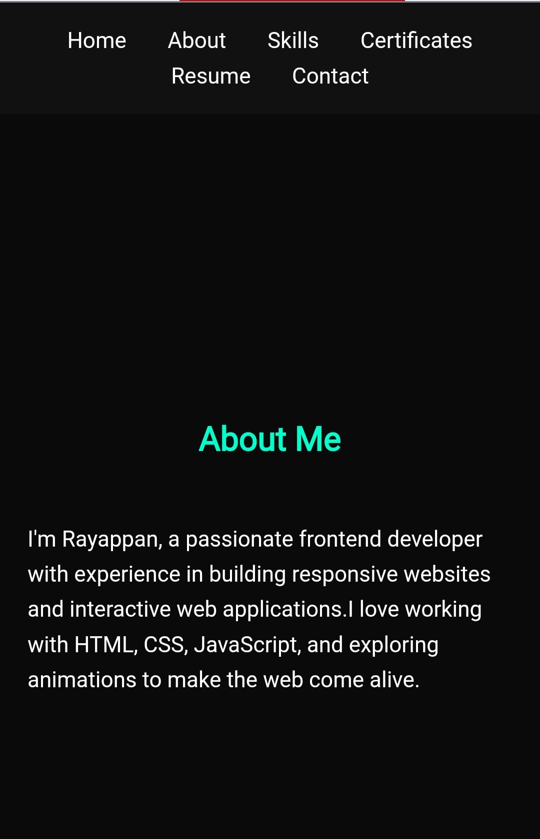
About

Slide 15
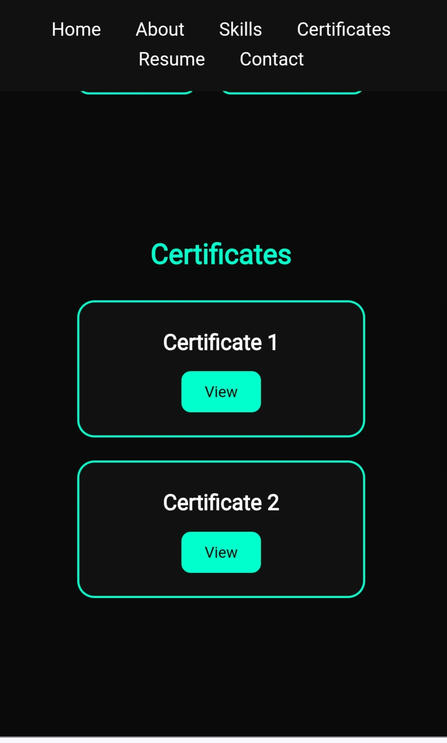
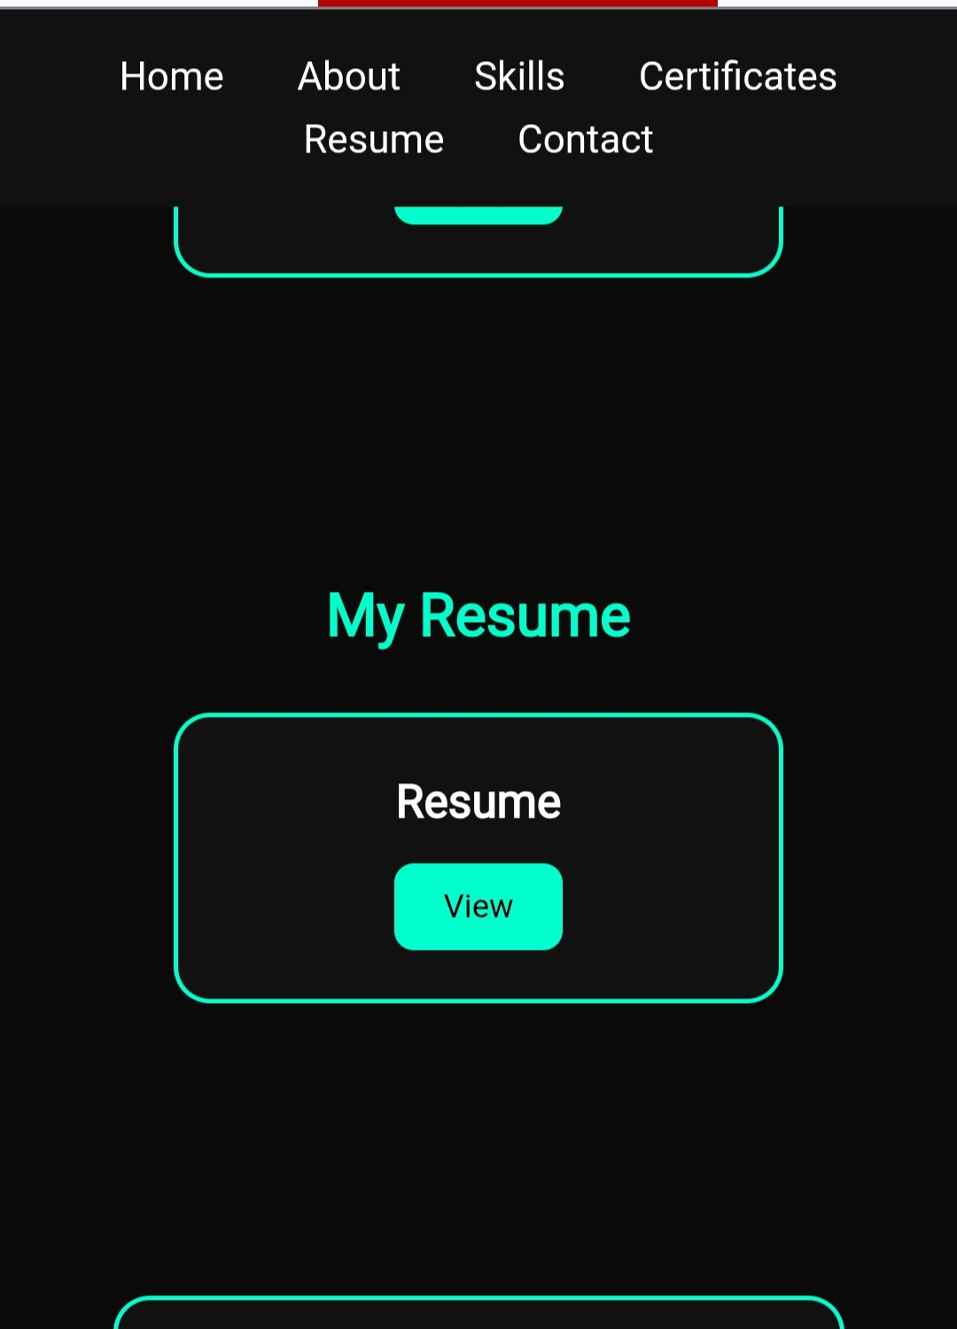
Certificates And Resume

Slide 16
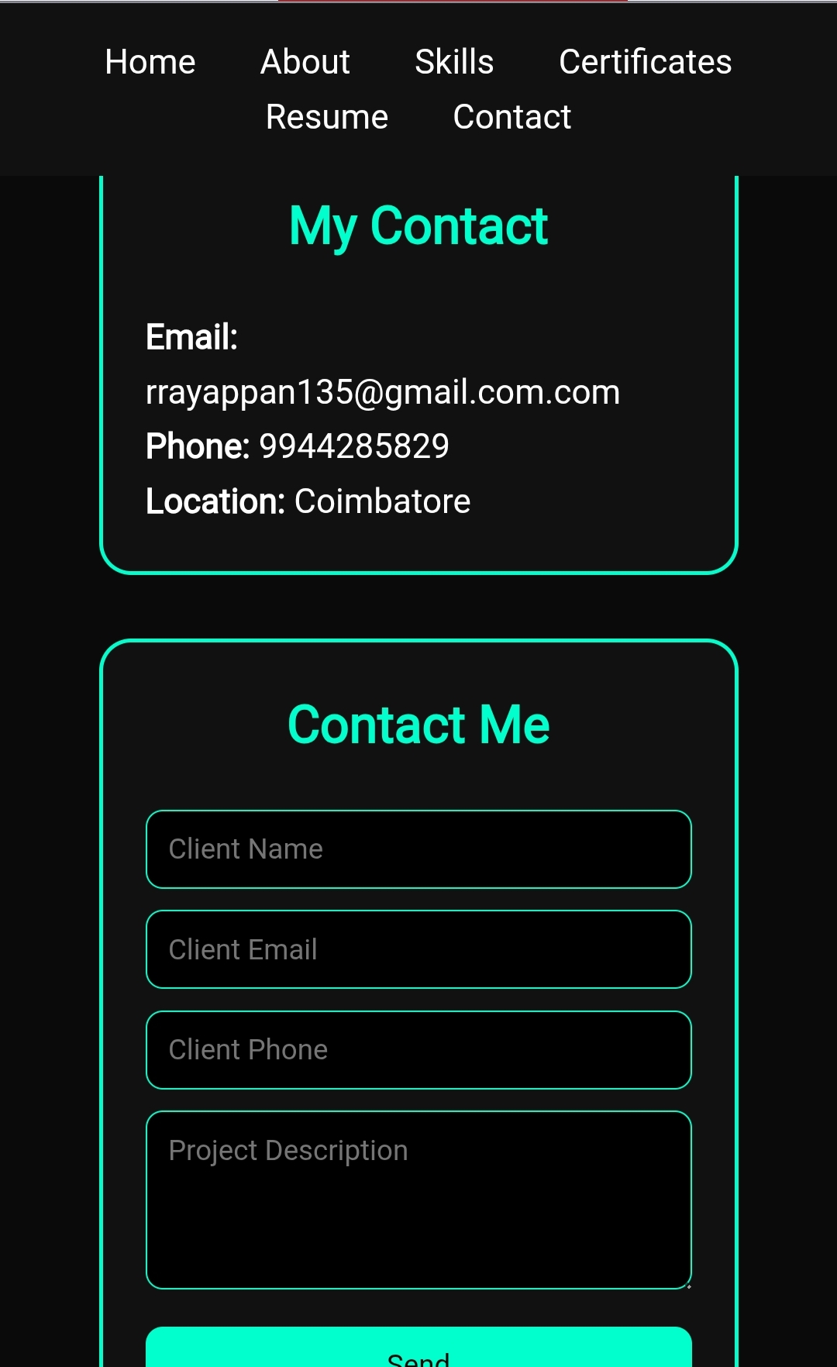
Contact

